Slide 1


Hope to Skills
Lecture# 17
Irfan Malik, Dr. Sheraz Naseer

Slide 2
Agenda
Linear Regression
Evaluation Metric for Linear Regression
Training a Regressor
Quiz

Slide 3
Linear Regression
Linear regression is a supervised machine learning algorithm used for predicting a continuous output (dependent variable) based on one or more input features (independent variables).

Slide 4
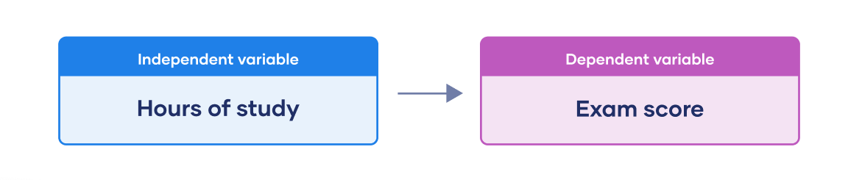
Dependent vs independent Variable

Slide 5
Why use Linear Regression?
Widely used in various fields, including finance, economics, and data science.
Great for making predictions and understanding relationships between variables.

Slide 6
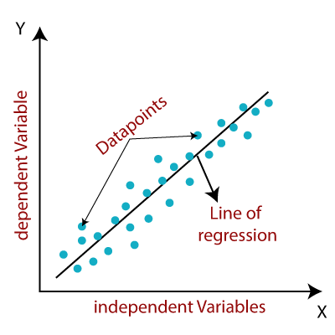
How does Linear Regression work?
It finds the best-fitting line that represents the relationship between X and Y.

Slide 7
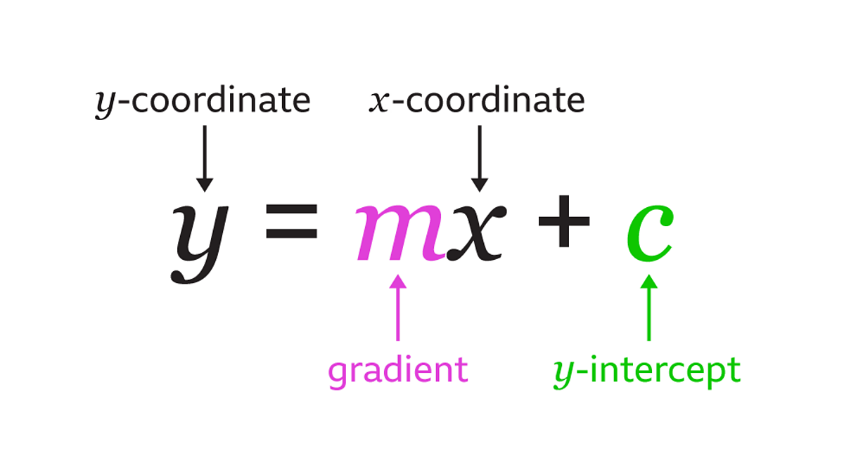
Understanding the Linear Equation
The linear equation: y = mx + c
y: The dependent variable (output/prediction we want to make)
x: The independent variable (input/feature)
m: The slope of the line (how much y changes when x changes)
b: The y-intercept (the value of y when x is 0)

Slide 8
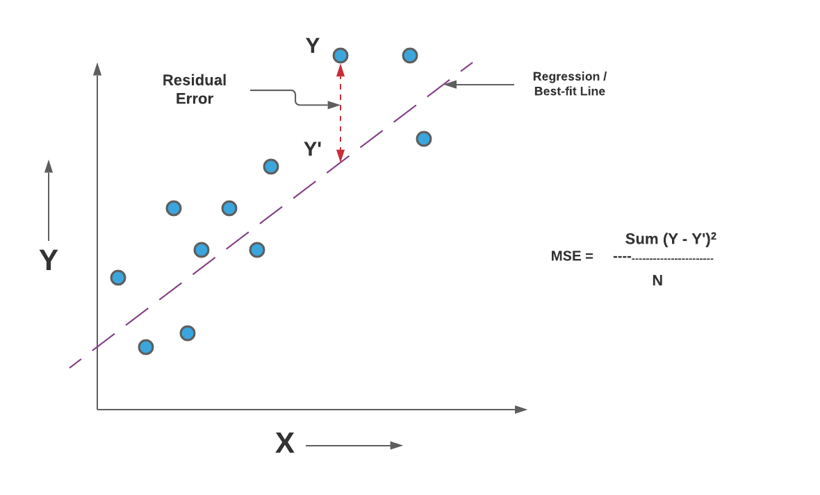
Mean Squared Error (MSE)
The Mean Squared Error (MSE) is a common evaluation metric used in regression tasks.
It measures the average squared difference between the actual and predicted values.

Slide 9
Lets move to Google collab

